Slide 1

SC||Institute of Skill
Circle

Slide 2
Breast Cancer
Prediction
Leveraging Machine Learning for
Breast Cancer Prediction
Presented by : Ravi Kumar

Slide 3
Introduction
Machine Learning technologies has wide range of potential uses in healthcare from improving patient data, medical research, diagnosis and treatment, to reducing costs and making patient safety more efficient.
Breast Cancer is considered one of the most common cancers in women caused by various clinical, lifestyle, social and economic factors.
Machine learning, with its predictive capabilities, offers a transformative approach to understating and predicting breast cancer in patients.
Through data-driven insights and predictive modelling, this presentation aims to showcase my Machine Learning Capstone Project focused on predicting breast cancer in the Healthcare Sector.

Slide 4
Why Healthcare
Domain?
Machine Leaning provides an exciting opportunity in healthcare to improve the accuracy of diagnoses, personalize healthcare, and find novel solutions to decades-old problems.
Application of Machine Leaning in Healthcare:
Improve trauma-care response: By creating sensors and devices that can send a patient’s vital information to the hospital before they arrive via ambulance or other emergency transport, there is less time between when the patient arrives and when they are able to receive life-saving treatment.
Disease prediction: You can use machine learning to find trends, create connections, and make conclusions baes on large data sets, This can include predicting disease outbreaks in communities and tracking habits leading to patient disease.
Visualization of biomedical data: You can use machine learning to create three- dimensional visualisations of biomedical data such as RNA sequences, protein structure, and genomic profiles.

Slide 5
Project’s Significance and its Benefits to Healthcare
Early Diagnosis: Combining multiple risk factors in modelling for breast cancer prediction could help the early diagnosis of the disease with necessary care plans.
Collection, storage, and management: of different data and intelligent systems baes on multiple factors for predicting breast cancer are effective in disease management.
Visualization of biomedical data: You can use machine leaning to create three-dimensional visualization of biomedical data such as RNA Sequences protein structure, and genomic profiles.
Improved diagnosis and disease identification: Identify previously unrecognisable symptom patterns and compare them with larger data sets to diagnose disease earlier in their developments.

Slide 6
Dataset
Information
Here are the key details about the dataset used in these project:
Number of records: Our dataset comprises of a comparatively smaller collection of data, consisting of 569 records. Each record represents a unique entry. Contributing to the richness and depth of our analysis.
Feature /Columns; The dataset is characterized by a diverse set of features. Features are computed from a digitized image of fine needle aspirate(FNA) of a breast mass. They describe characteristics of the cell nuclie present in the image. In total, there are 30 features/Columns that form the basis of our predictive modelling.
Source of the Data: the dataset is sourced from Skill Circle, ensuring reliability and relevance, The data’s origin plays a crucial role in shaping the context and ensuring that our analysis is grounded in real-world scenarios and industry dynamics.

Slide 7
Exploratory Data Analysis (EDA)
Exploring the data allowed us to gain a comprehensive overview of the data’s structure. It uncovered potential patterns, helped us identify key trends and get essential insights from the dataset.
Throughout the EDA process, we analysed the distribution of individual features, investigated correlations, and explored any inherent relationships between variables.
Visualizations also played a crucial role in providing a clear representation of the data, offering insights into breast cancer prediction.

Slide 8
Exploratory Data Analysis (EDA)
First, we made sure there were no Null values and Duplicates in the dataset. There was only one column with null values which was dropped since it only had null values. Our dataset was clean to begin with.
Then we checked our columns to see if they were providing nay useful information for us to work with, We found out that columns like “ID” was not contributing much to the predictions. Hence, we decided to drop them during preprocessing.
Some columns were highly correlated and could lead to overfitting and hence were dropped.
To ensure consistent scales for numerical features we decided to employ Standard Scaler during preprocessing.

Slide 9
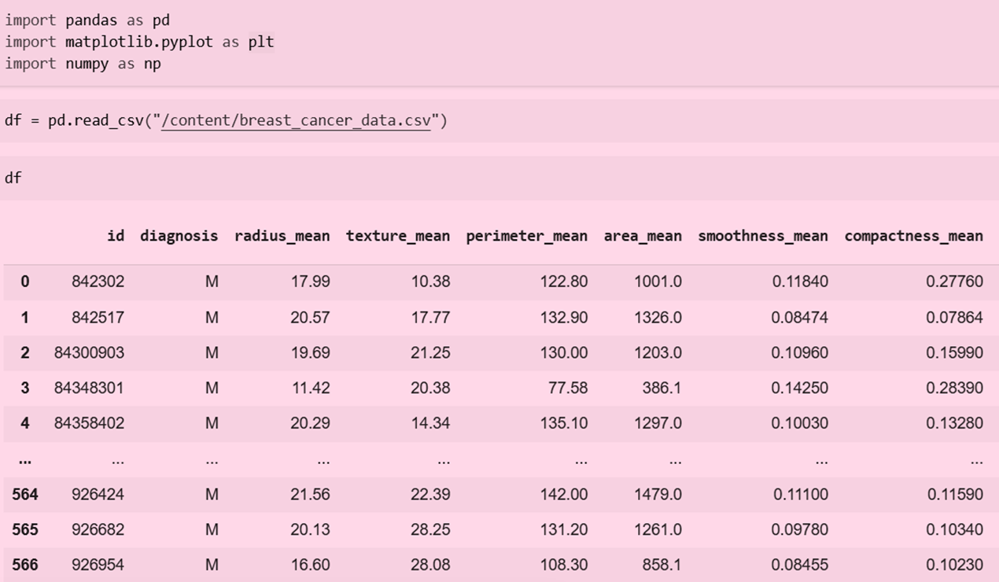
Pandas: for loading and handling tabular data.
Matplotlib: For plotting/ Visualization
Numpy: For numerical operation

Slide 10
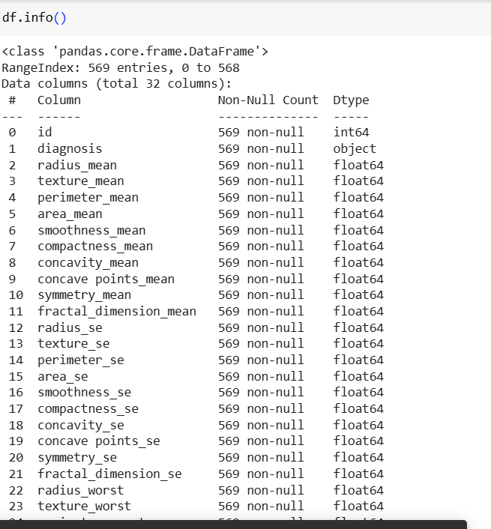
The DataFrame has 569 rows, indexed has 0 to 568.
There are 32 Columns.

Slide 11
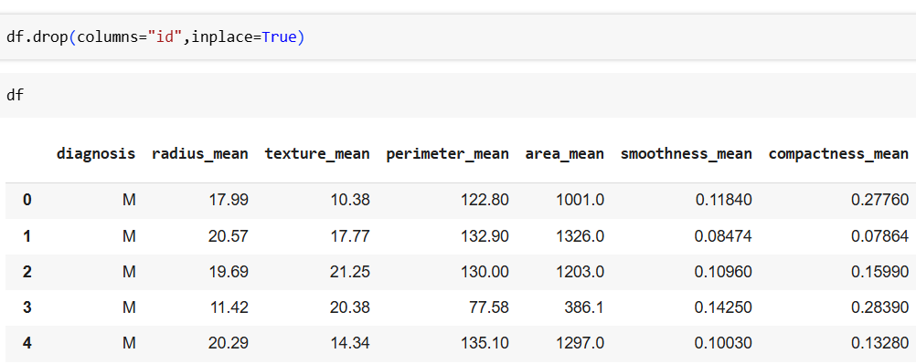
We Drop the “Id” Column. It is not useful for us to find anything.

Slide 12
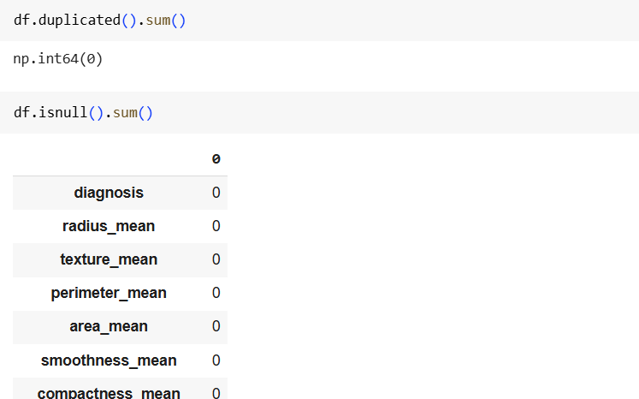
We are check both duplicates and Null Values. There is no Null Values We can proceed further.

Slide 13
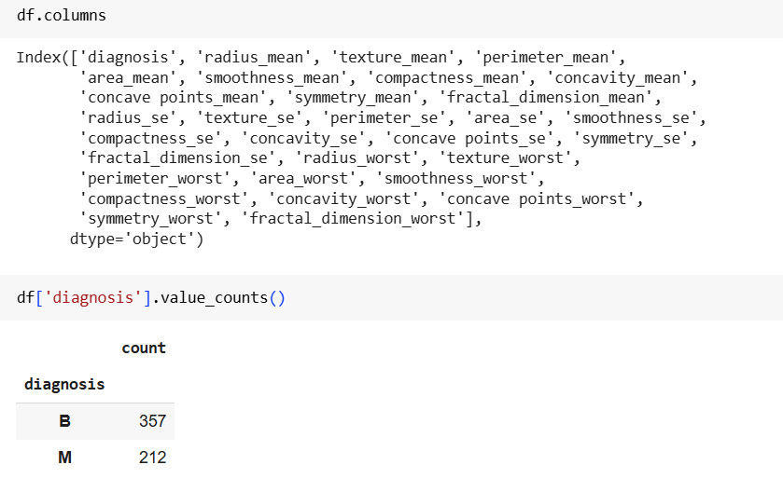
We check all column names.
We found out no. of values of diagnosis malignant and benign.
B=357
M=212

Slide 14
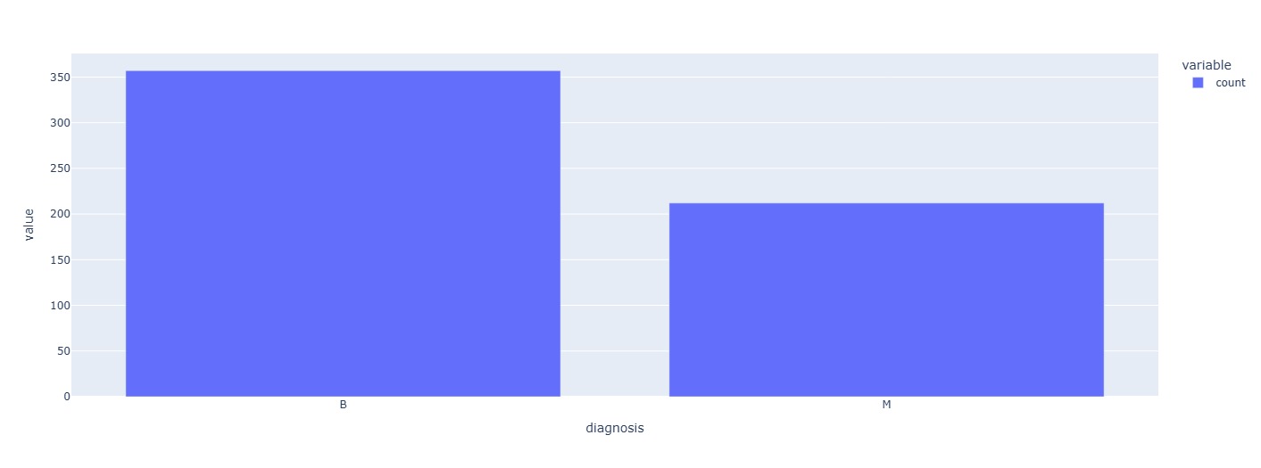
Our target variables ‘Diagnosis’ has 357 Benign (Negative cases) and
212 Malignant (Positive Cases).

Slide 15
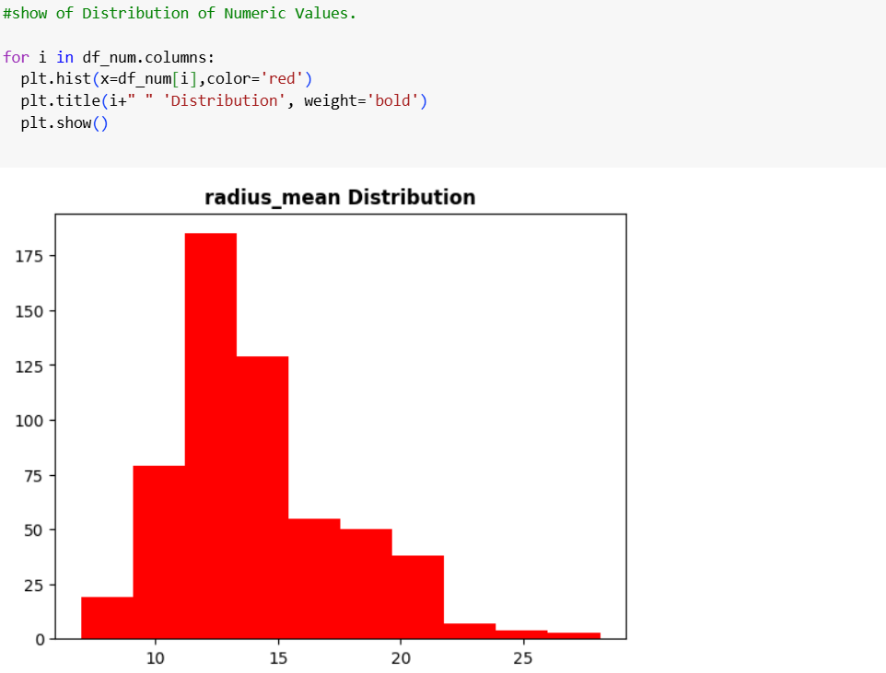
Show Distributions of Numeric Values

Slide 16
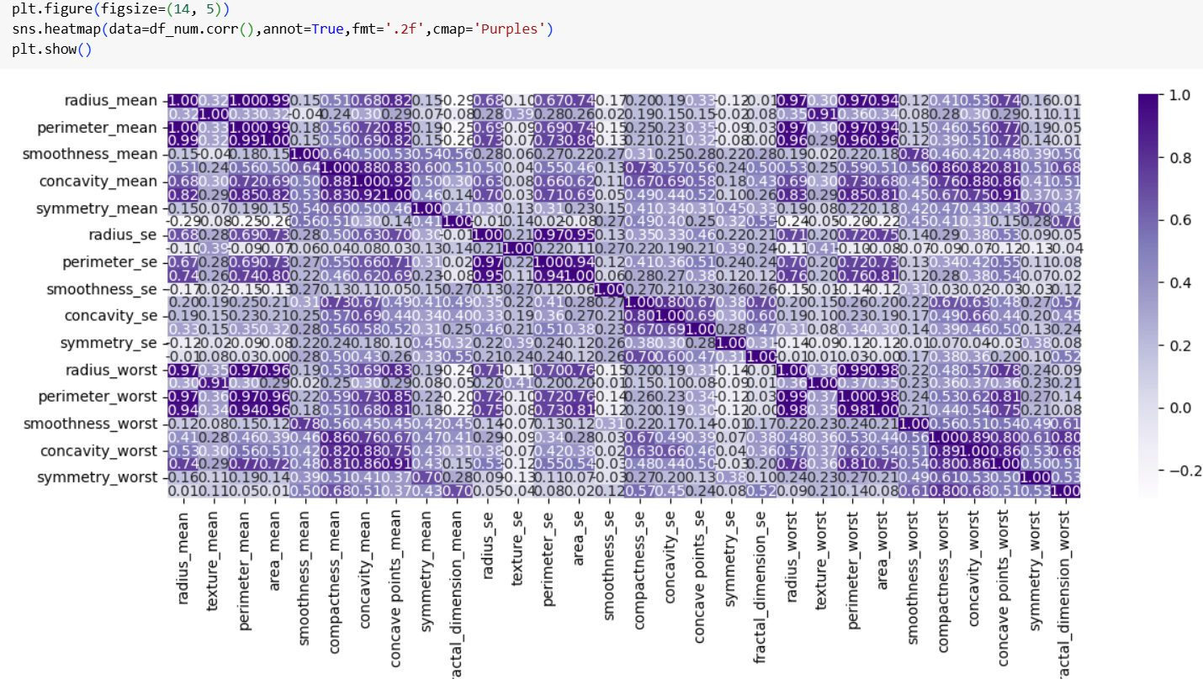
Below inspecting the heatmap, we can see that there is multicollinearity observed among the columns. As a result, some columns will be dropped.

Slide 17
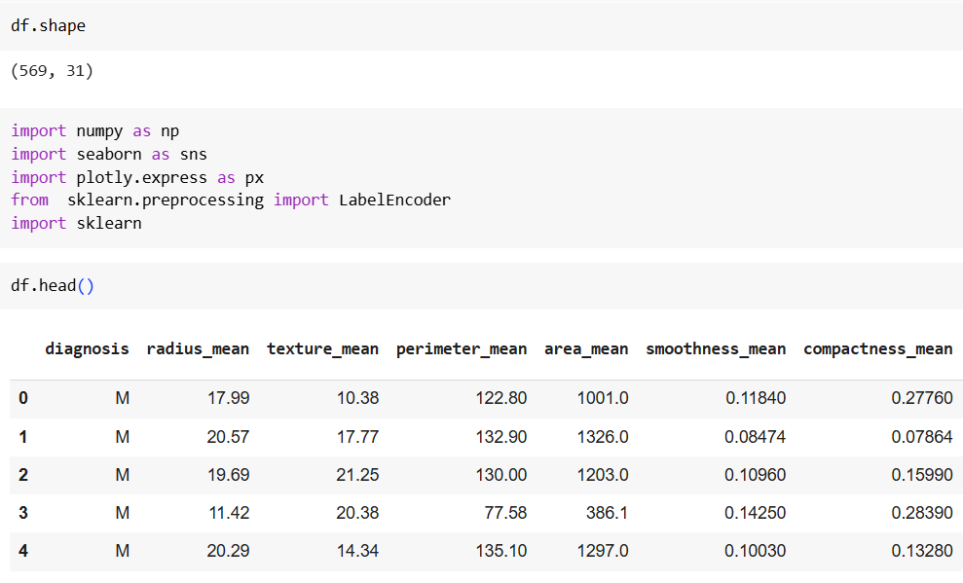
569 rows → 569 tumor samples (patients)
31 columns → 1 target column (diagnosis) + 30 feature columns (like radius_mean, area_mean, etc.)
Imports (Libraries)

Slide 18
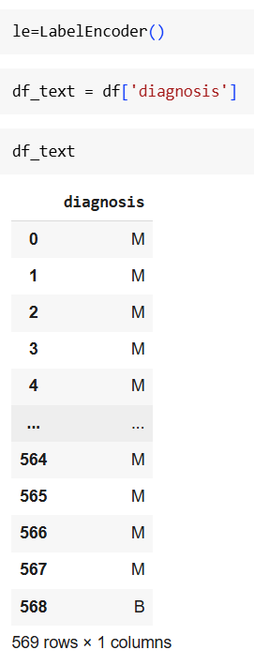
M : 1
B : 0
Encoding of Categorical Data

Slide 19
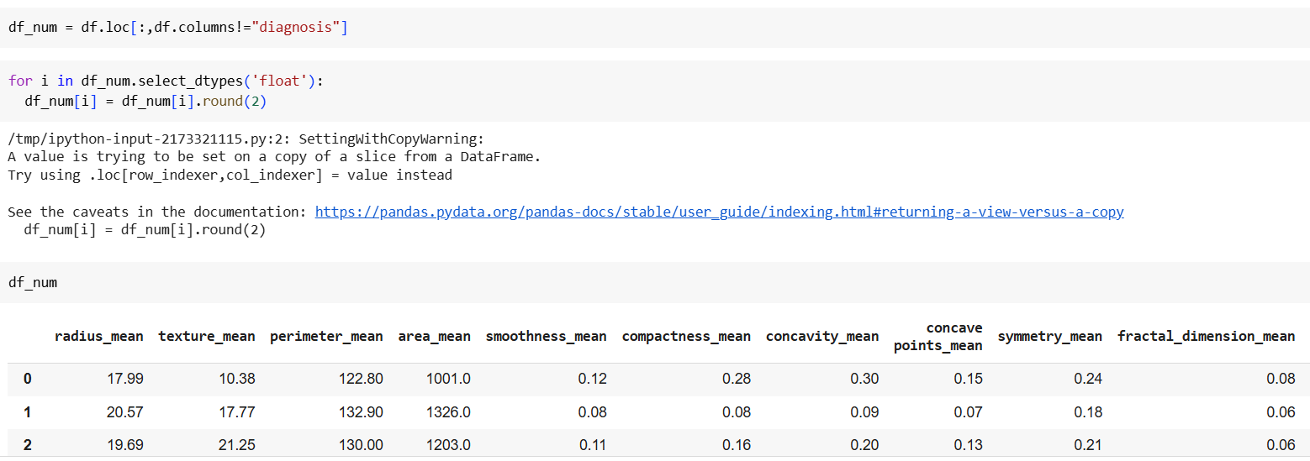
Define independent and Dependent Variable

Slide 20
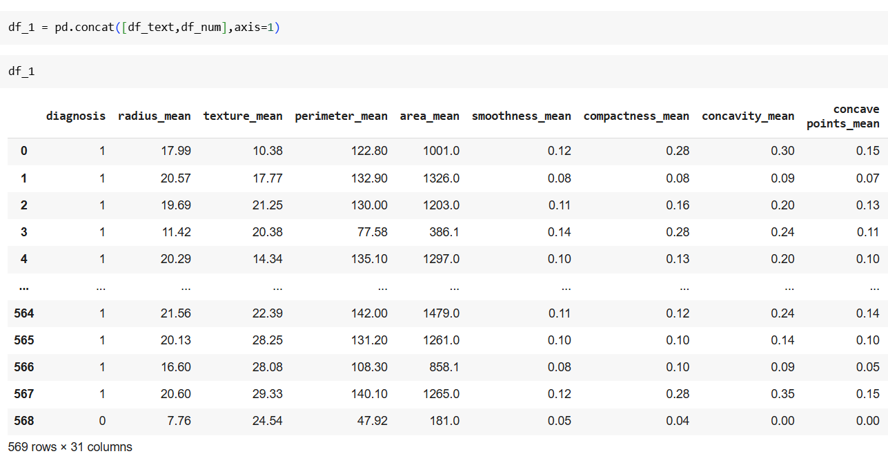
Concating both df_text and df_num.

Slide 21
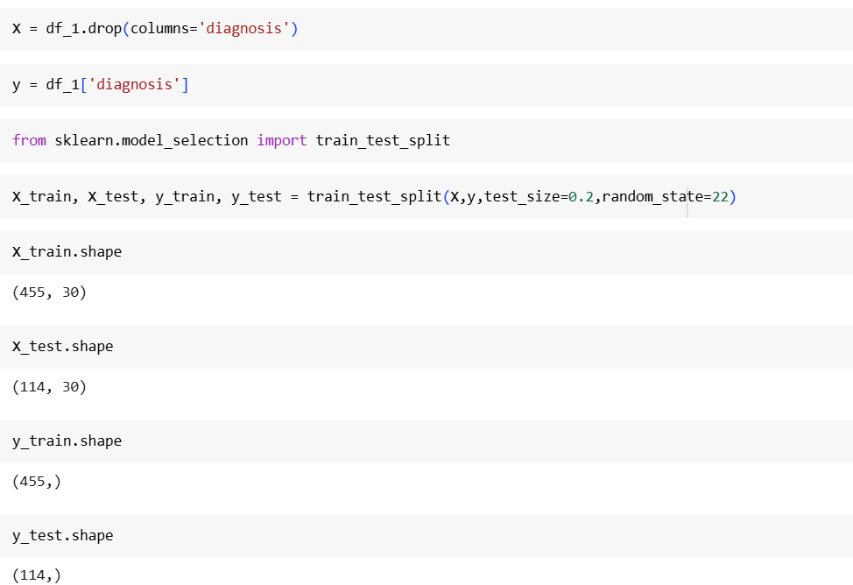
Train-Test Split
We then Split the data into training and testing data.
We did an 80:20 split, meaning 80% of our data is Training Data and 20% of our data is Testing Data, So, our test size was set to 0.2.
We took Random Stare as 40. This guaranteed the reproducibility of our results across different runs.
We also used stratify = y to ansure that our Target Variable (y) is distributed proportionally.

Slide 22
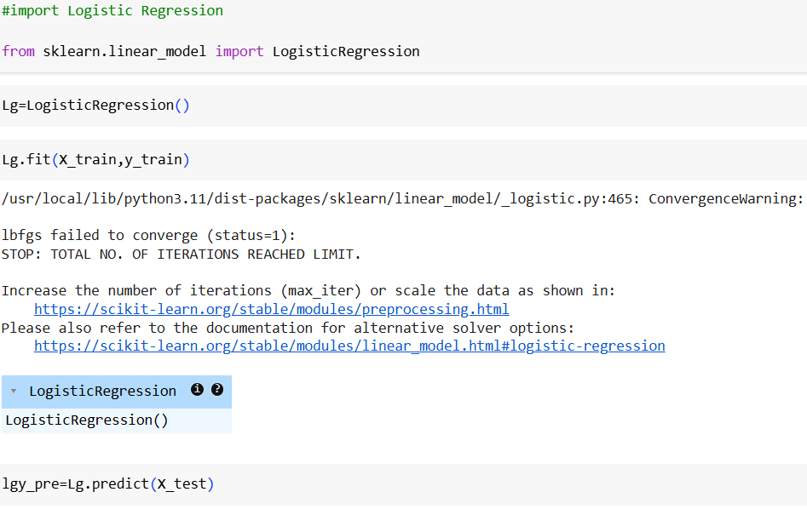
Logistic Regression : Logistic Regression is a powerful tool in binary classification. Its very good at modelling the probability of an event occurring, making it suitable for scenarios where understanding the likelihood of breast cancer cells is essential.
We importing Logistic Regression from scikit-learn.
Lg = LogisticRegression() initializes the model.
Lg.fit(X_train, y_train) trains the model on your training data.

Slide 23
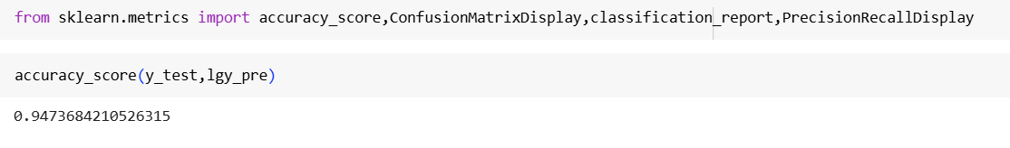
Model Accuracy score is 94% .

Slide 24
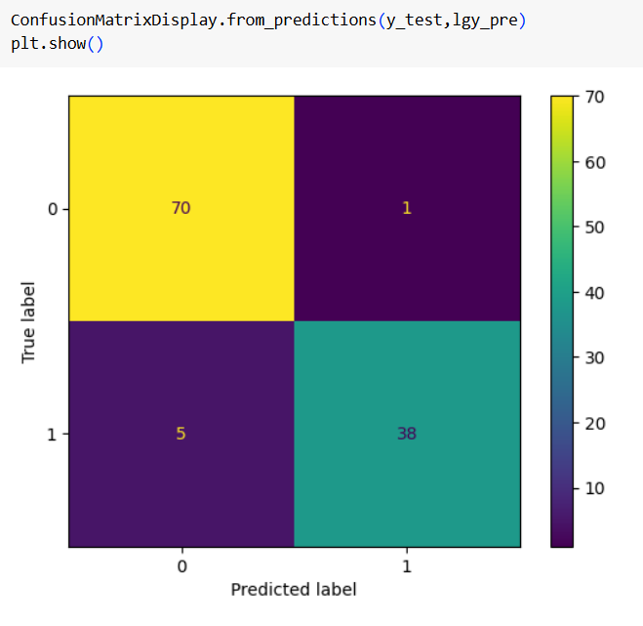
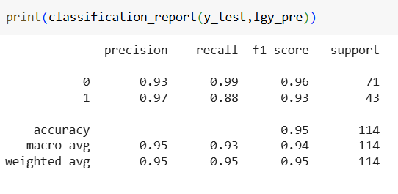
Confusion Matrix
Classification report

Slide 25
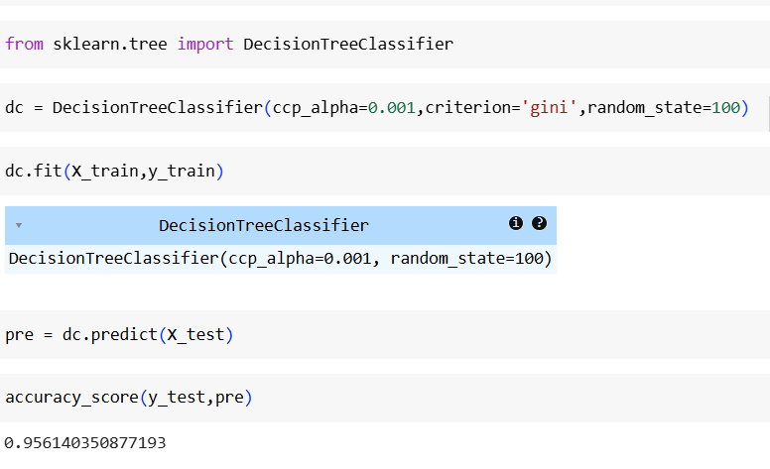
We importing DecisionTree from scikit-learn. dc =DecisionTreeClassifier() initializes the model. dc.fit(X_train, y_train) trains the model on your training data.
Accuracy of model is 96%

Slide 26
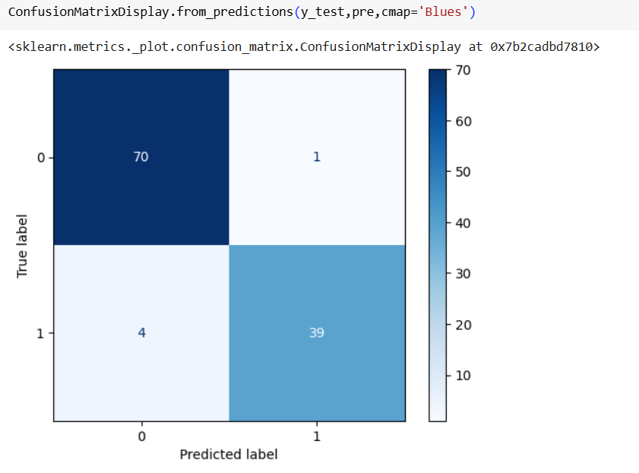
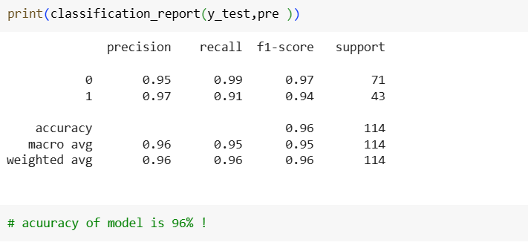
Confusion Matrix
Classification report

Slide 27
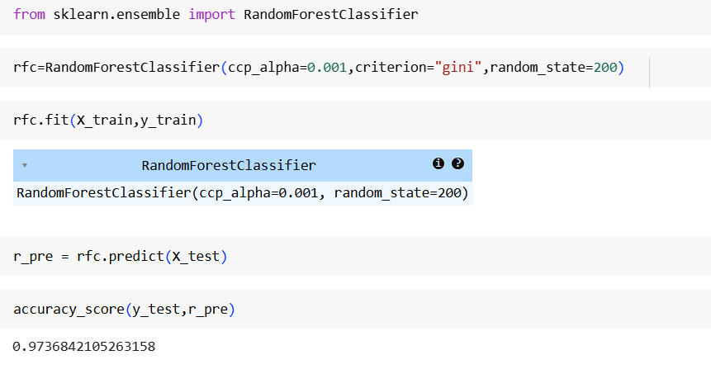
We importing Random Forest Classifier from scikit-learn.
rfc = RandomForestClassifier() initializes the model.
rfc.fit(X_train, y_train) trains the model on your training data.

Slide 28
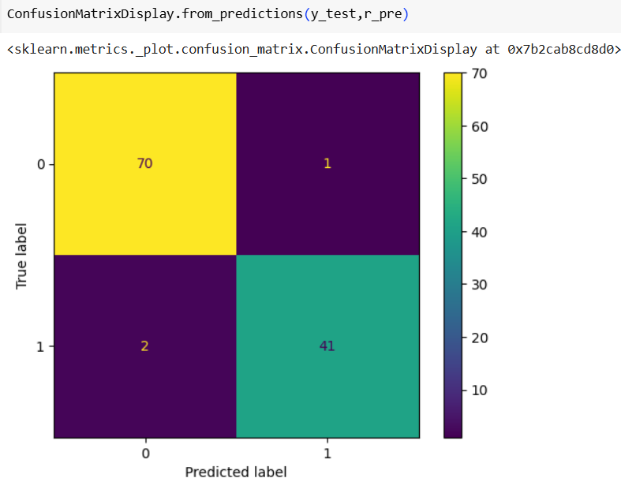
Confusion Matrix

Slide 29
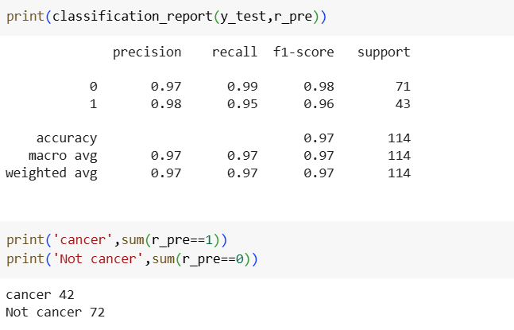
Classification Report

Slide 30
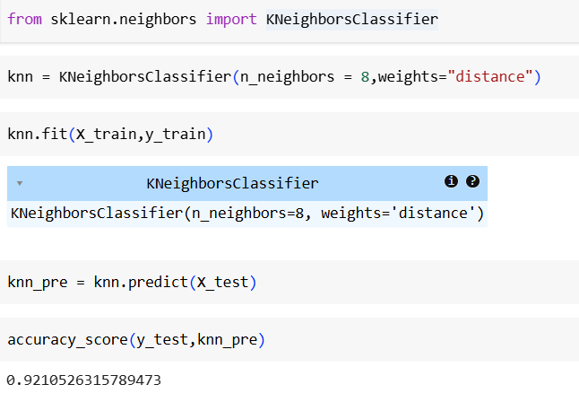
We're using the K-Nearest Neighbors (KNN) algorithm to classify tumors.
We set n_neighbors=8 and used distance weighting so closer neighbors have more influence.
After training with knn.fit, you predicted on test data using knn.predict.
The model achieved an accuracy of ~92.1%, meaning it correctly classified ~92% of test samples.

Slide 31
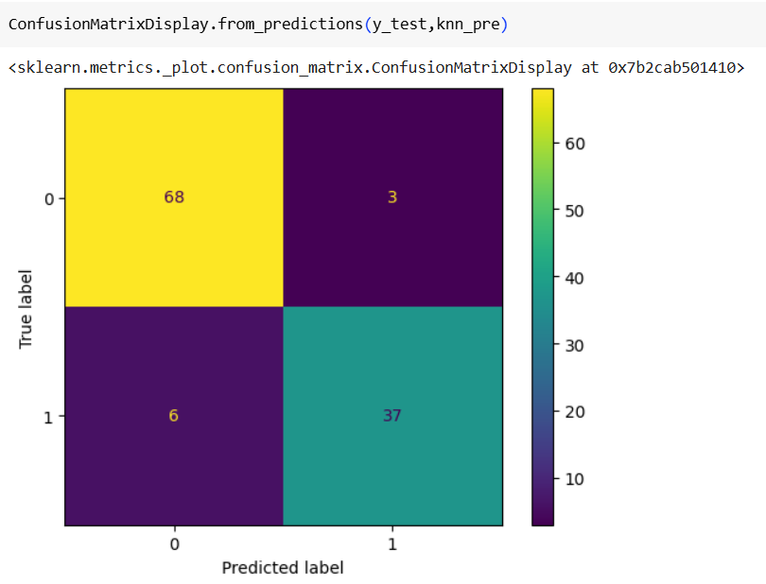
68 true negatives (class 0 correctly predicted), 37 true positives (class 1 correctly predicted)
3 false positives (predicted 1, actually 0), 6 false negatives (predicted 0, actually 1)
The model performs well, but slightly more false negatives than false positives.

Slide 32
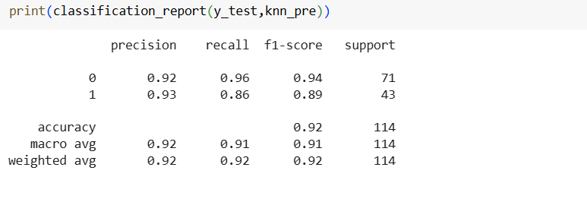
1.The KNN model achieved 92% overall accuracy on the test data.
2.For class 0, recall is high (0.96), meaning it catches most actual class 0s.
3.For class 1, precision is slightly better (0.93), but recall drops to 0.86.
4.The model performs slightly better on class 0, but still gives balanced results overall.

Slide 33
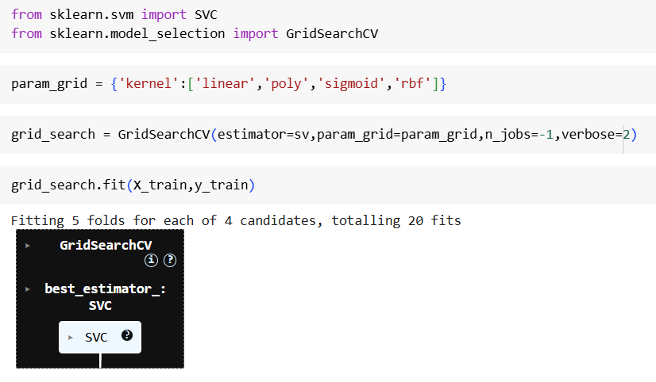
This code uses GridSearchCV to find the best SVM kernel for the model.
It tests 4 kernel options: 'linear', 'poly', 'sigmoid', and 'rbf' using 5-fold cross-validation. n_jobs=-1 enables parallel computation to speed up the process.
The best-performing kernel is selected and stored in best_estimator_.

Slide 34
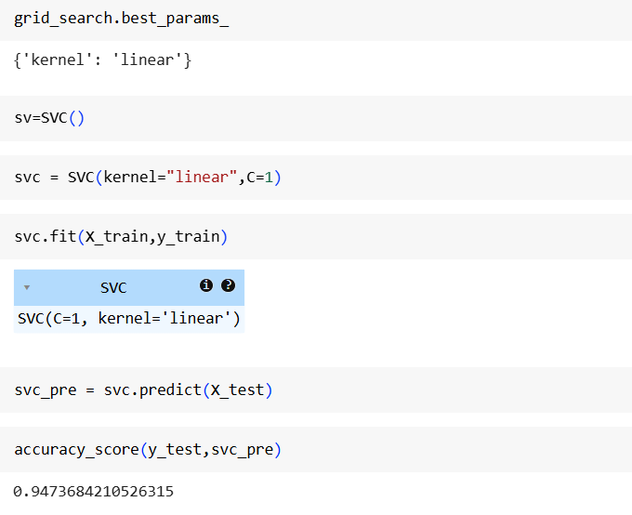
GridSearchCV selected 'linear' as the best kernel for SVM.
The SVM model is then initialized with kernel='linear' and C=1.
It is trained using X_train and y_train, and predictions are made on X_test.
The model achieved an accuracy of 94.7% on the test set.

Slide 35
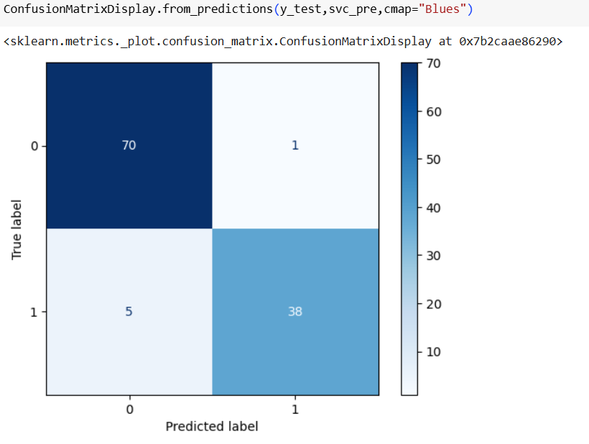
The confusion matrix shows 70 true negatives and 38 true positives.
There is 1 false positive (predicted 1 instead of 0) and 5 false negatives (predicted 0 instead of 1).
This indicates the SVM model performs well on both classes.
Most predictions align with the true labels, confirming high accuracy.

Slide 36
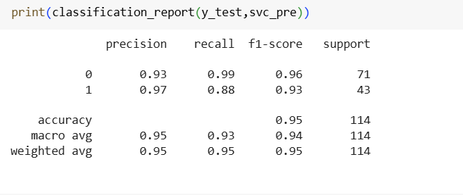
Classification Report
The SVM model achieved 95% accuracy on the test data.
Class 0 had precision 0.93 and recall 0.99, meaning very few false positives.
Class 1 had precision 0.97 and recall 0.88, showing some false negatives.
Overall, the model performs well with balanced precision, recall, and F1-score.

Slide 37
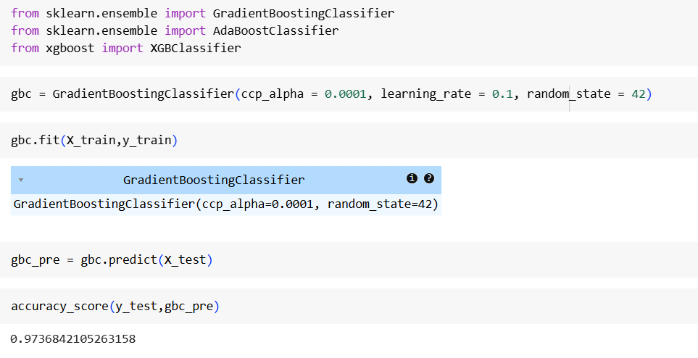
GradientBoostingClassifier is imported and initialized with parameters like ccp_alpha, learning_rate, and random_state.
The model gbc is trained on the training data using gbc.fit(X_train, y_train).
Predictions are made on the test set using gbc.predict(X_test).
Accuracy is calculated by comparing predictions with actual test labels, resulting in ~97.4%.

Slide 38
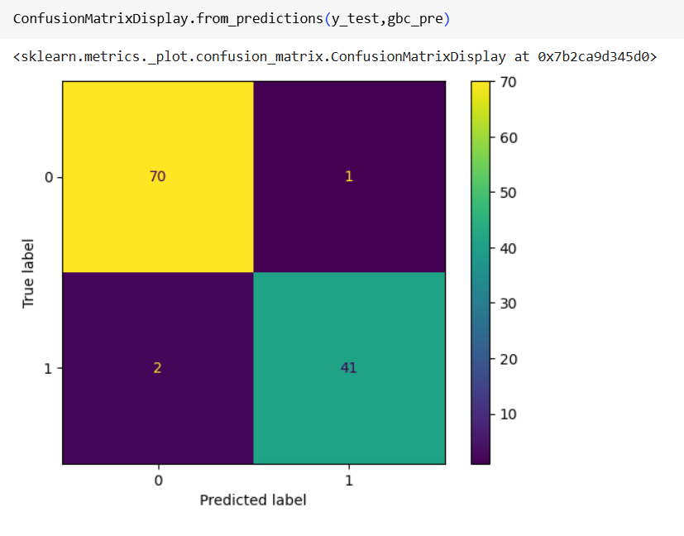
Confusion Matrix
70 true negatives (label 0 predicted correctly) and 41 true positives (label 1 predicted correctly).
1 false positive (predicted 1 but true label was 0) and 2 false negatives (predicted 0 but true label was 1).
The model is performing well with only 3 misclassifications out of 114.
Most predictions are accurate, indicating high precision and recall.

Slide 39
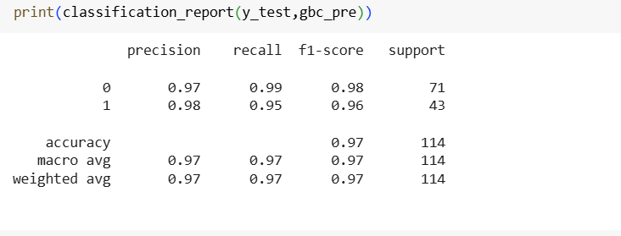
Classification Matrix
Class 0: Precision = 0.97, Recall = 0.99, F1-score = 0.98
Class 1: Precision = 0.98, Recall = 0.95, F1-score = 0.96
Overall accuracy is 97% on 114 samples.
Both macro and weighted averages are 0.97, indicating balanced performance.

Slide 40
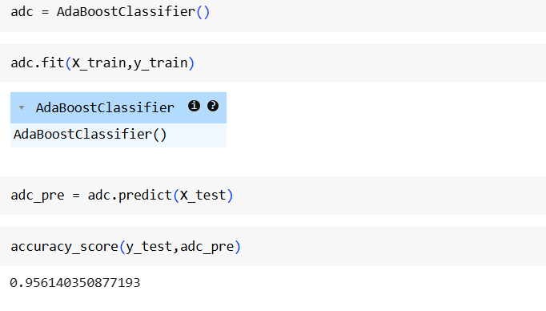
This code trains an AdaBoostClassifier on the training data.
It makes predictions on the test set usingadc.predict(X_test).
The accuracy score of the model is 0.9561 or 95.61%.
This indicates that AdaBoost performed well on the test data.

Slide 41
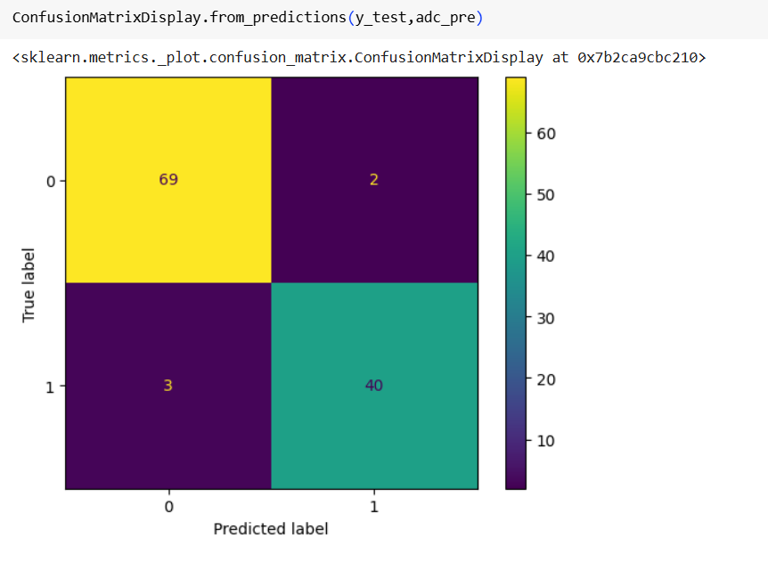
69 true negatives and 40 true positives were correctly predicted.
2 false positives and 3 false negatives occurred.
The model made 5 total misclassifications, showing good but slightly lower performance than the previous model.

Slide 42
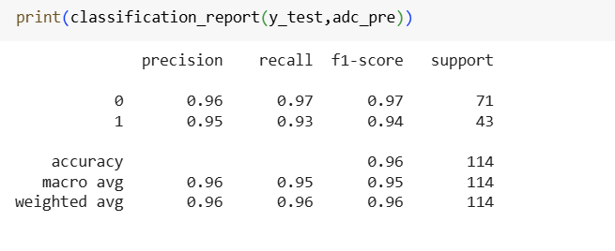
Classification matrix
Class 0: F1-score = 0.97, Class 1: F1-score = 0.94
Overall accuracy is 96% on 114 test samples.
Both macro and weighted averages are 0.95–0.96, showing balanced performance.

Slide 43
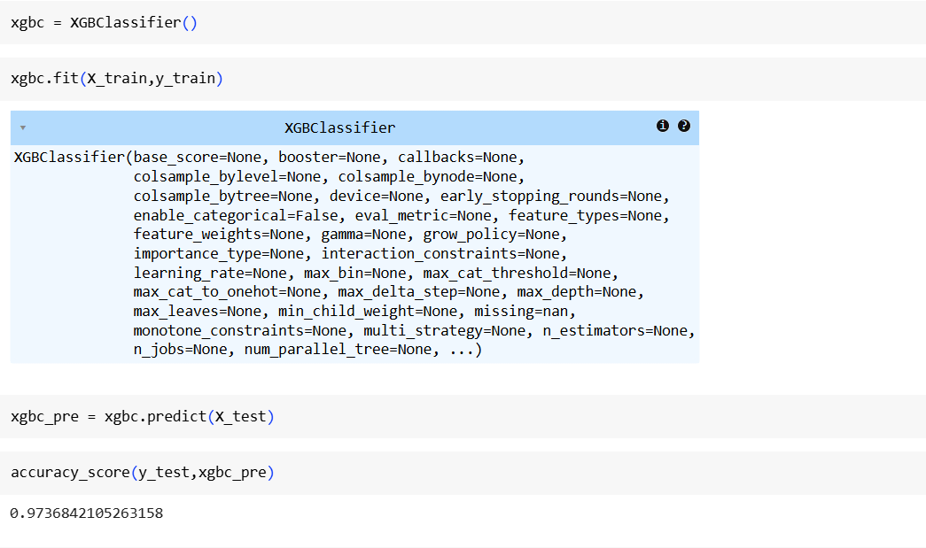
This code trains an XGBoost Classifier on the training data.
It predicts outcomes on the test set using xgbc.predict(X_test).
The model achieved an accuracy of 97.37%, indicating excellent performance.
XGBoost slightly outperforms AdaBoost and is close to Gradient Boosting in this case.

Slide 44
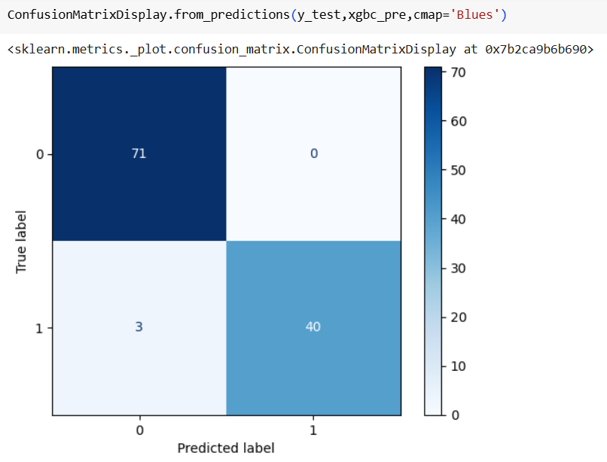
Confusion Matrix
True Negatives (TN): 71 – Model correctly predicted class 0.
False Positives (FP): 0 – No class 0 wrongly predicted as class 1.
False Negatives (FN): 3 – 3 class 1 samples wrongly predicted as class 0.
True Positives (TP): 40 – Model correctly predicted class 1.
✅ Conclusion: Very strong performance, especially with no false positives. Just a few false negatives.

Slide 45
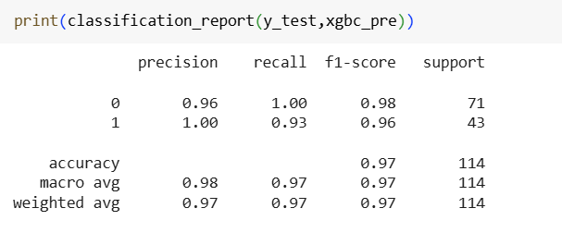
Classification Matrix
Accuracy: 97% – Out of 114 samples, the model predicted 111 correctly.
Class 0 (label 0): Precision = 0.96, Recall = 1.00 → All actual 0s were identified correctly.
Class 1 (label 1): Precision = 1.00, Recall = 0.93 → A few 1s were missed, but all predicted 1s were correct.
F1-score: Balanced at 0.97 overall – showing strong model performance across both classes.

Slide 46
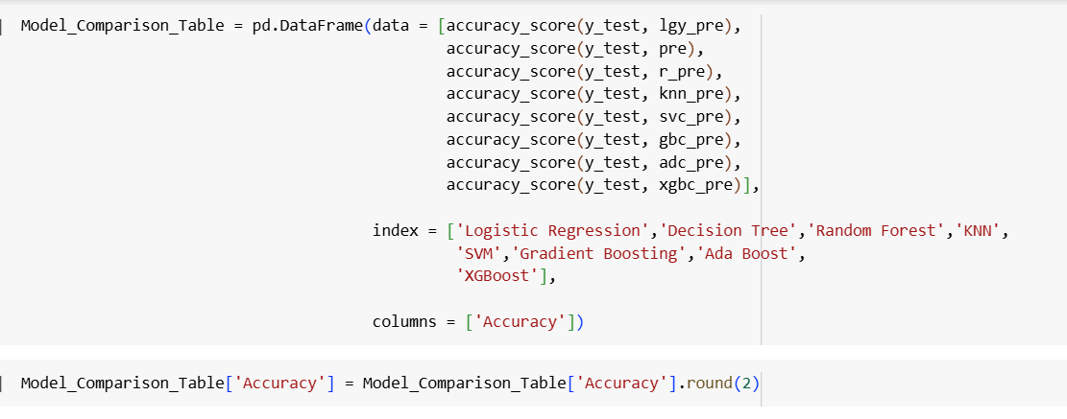
Model Comparison Table

Slide 47
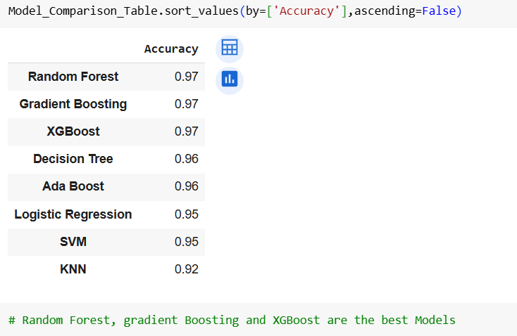
All accuracy Model

Slide 48
Model Selection and considerations
XG boost outperforms Logistic Regression, Random Forest, Decision Tree and gradient boost in all metrics, demonstrating higher Accuracy, Precision Recall and F1-Score. It seems to be a promising model for our task.
Based on the provided metrics, Xgboosting stand out as the best performing model overall. It achieves a good balance between precision and recall, making it suitable for our Brest Cancer prediction task.
Hence we will go with XGBoost Classification as our final model as it is quite evident that it performs best for our Brest Cancer problem.

Slide 49
Conclusion
With the help of several insights, patterns and trends in our data, we have used Machine Learning to address the intricate challenge of predicting Brest Caner.
This project offers significant benefits to banks:
Combining multiple risk factors in modelling for breast cancer prediction could help the early diagnosis of the disease with necessary care plans.
Collection storage and management of different data and intelligent systems based on multiple factors for predicting breast cancer are effective in disease management.
The proposed machine-learning approaches could predict breast cancer as the early detection of this disease could help slow down the progress of the disease and reduce the mortality rate through appropriate therapeutic interventions at the right time.

Slide 50
Thanks You!

